Slide 1

A Project Review Meeting on Personal Knowledge Capsule
By
Name V.Sanjay roll 242003030014
Name P.Rahul roll 2420030368
Name M.V.S Aasrith roll 24200303573
Team Number: 13
Under the guidance of
Dr Kavitha Lakshmi M
Associate Professor
Department of Computer Science and Engineering
Koneru Lakshmaiah Education Foundation (Deemed to be University estd. u/s. 3 of the UGC Act, 1956) Off-Campus: Bachupally-Gandimaisamma Road, Bowrampet, Hyderabad, Telangana - 500 043. Phone No: 7815926816, www.klh.edu.in

Slide 2
Outline of the Presentation
Abstract
Introduction
Problem Statement
Project Flow Diagram
Objectives with Justification
Modules[Frontend web pages]
Expected Outcomes of the Proposed Work
Conclusion
References

Slide 3
Abstract
In today’s digital environment, individuals generate large amounts of personal knowledge such as notes, ideas, and study materials, which are often stored in an unorganized manner across multiple platforms, making retrieval difficult. The lack of a centralized and structured system results in loss of valuable information and reduced productivity. To address this issue, the Personal Knowledge Capsule is proposed as a full-stack web application that provides a centralized platform for storing, organizing, and retrieving personal knowledge efficiently.
The system allows users to create knowledge entries and organize them using categories and moods to enable context-based retrieval. Users can also filter and sort stored information based on parameters such as category, mood, and creation date. The backend of the application is developed using Spring Boot, while Hibernate with JPA is used for efficient database interaction. RESTful APIs support CRUD operations, ensuring scalability and seamless integration with front-end applications. Overall, the proposed system offers a simple, efficient, and user-friendly solution for effective personal knowledge management.

Slide 4
Introduction
The Personal Knowledge Capsule is proposed to address these challenges by providing a centralized, digital platform for storing, organizing, and retrieving personal knowledge in a systematic manner. The system enables users to create knowledge entries and categorize them using meaningful parameters such as categories and moods, allowing context-based retrieval. Advanced filtering and sorting features further enhance accessibility and usability.
Developed as a full-stack web application, the system utilizes modern technologies to ensure scalability, efficiency, and ease of use. The backend is implemented using Spring Boot with Hibernate and JPA for robust database management, while RESTful APIs facilitate seamless communication with front-end applications. Overall, the Personal Knowledge Capsule aims to improve personal knowledge management by offering a simple, efficient, and user-friendly solution.

Slide 5
Problem Statement
Personal knowledge is scattered across notebooks and apps
Retrieving information is time-consuming
Lack of structure reduces productivity
Need for a centralized knowledge system

Slide 6
Project Flow Diagram
System Architecture – Personal Knowledge Capsule
User Interface (Frontend) HTML | CSS | JavaScript
Spring Boot Application
Controller Layer REST APIs
Service Layer Business Logic
Repository Layer Spring Data JPA
MySQL Database knowledge_items

Slide 7
Objectives with Justification
Objectives:
Structured storage
Easy retrieval
User-friendly design
Proposed Solution:
Centralized digital storage of knowledge
Category and mood-based organization

Slide 8
Modules [Frontend web pages]
The Frontend Web Pages module provides the user interface for interacting with the Personal Knowledge Capsule system. It is developed using HTML, CSS, and JavaScript to ensure a responsive and user-friendly experience. This module allows users to create, view, update, and delete personal knowledge entries. Users can organize their knowledge using categories and moods, and easily search, filter, and sort stored information based on different parameters. The frontend communicates with the backend through RESTful APIs to perform all operations efficiently. Overall, this module ensures smooth navigation, ease of use, and effective interaction with the system.

Slide 9
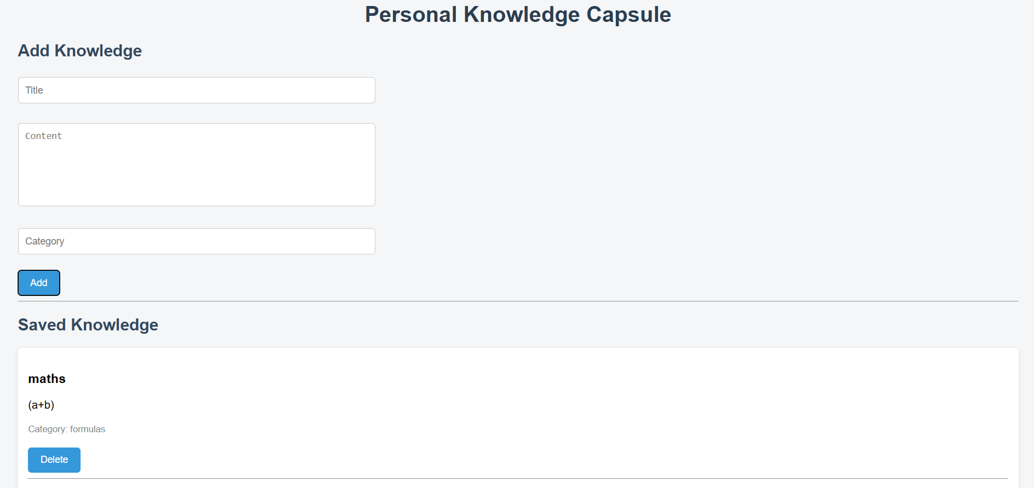
Expected Outcomes of the Proposed Work

Slide 10
Conclusion and Future Scope
Advantages:
Simple and user-friendly
Organized storage
Easy retrieval
Use Cases:
Personal notes
Academic learning
Idea organization
Conclusion:
Efficient and scalable knowledge management system

Slide 11
References
Spring Boot Documentation – Spring Boot Reference Guide.
Hibernate ORM Documentation – Hibernate User Guide.
Java Persistence API (JPA) Specification – Oracle Documentation.
MySQL Documentation – MySQL 8.0 Reference Manual.
RESTful Web Services – Roy T. Fielding, Architectural Styles
W3C Documentation – HTML, CSS, and JavaScript Standards.

Slide 12
Thank you

